Slide 1

Windows PC Mastery
Exploring Software Fundamentals, System Management, and Workspace Personalization

Slide 2
Software Fundamentals
Understanding the core components and utilities that drive your computer's functionality.

Slide 3


Application vs. Utility Software
Application Software
Utility Software
Designed specifically for end-users to perform productive tasks. Examples include web browsers, word processors (like Microsoft Word), media players, and creative suites. This is the software you actively interact with to produce and consume content.
Designed to help analyze, configure, optimize, or maintain a computer. It operates mostly in the background, supporting the computer's infrastructure. Common examples include antivirus tools, backup software, and disk defragmenters.

Slide 4









Key Utility Categories
Security
Optimization
Maintenance
Protects the system from malware, viruses, and unauthorized access. Firewalls, antivirus programs, and encryption tools are critical for data safety.
Improves system performance by organizing data blocks, cleaning temporary application files, and managing startup programs for faster boot times.
Includes built-in diagnostic tools for identifying hardware issues, managing connected devices, and ensuring overall operating system stability.

Slide 5
Windows System Management
Utilizing built-in administration tools to keep your operating system secure and running smoothly.

Slide 6

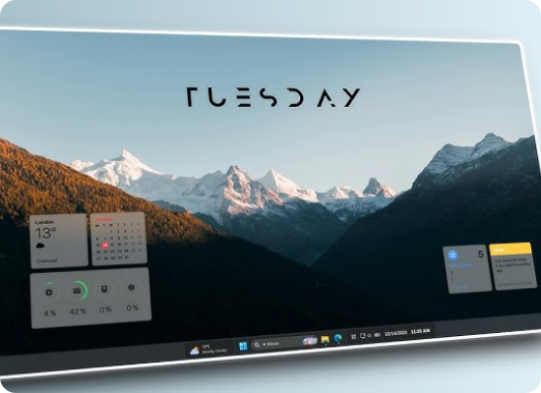
Device Management
•
Device Manager: A critical Windows applet that allows you to view, control, and configure the hardware currently attached to the computer.
•
Driver Updates: Ensure your graphics card, network adapters, and external peripherals have the latest manufacturer software to function properly.
•
Troubleshooting: Quickly identify hardware conflicts, missing drivers, or physical devices that are failing to initialize.
•
Enable/Disable: Temporarily turn off problematic hardware components without needing to physically disconnect them from the motherboard.

Slide 7

Disk Optimization
Defragment & Optimize Drives
Over time, files saved on traditional hard disk drives (HDDs) become fragmented, meaning pieces of a single file are scattered across the disk. This drastically slows down read and write speeds.
The Windows Defragmentation tool physically reorganizes these scattered data blocks into contiguous spaces. For modern Solid State Drives (SSDs), Windows instead uses a specialized optimization process called TRIM to maintain peak data transfer speeds.

Slide 8




Windows Defender Security
Real-time Virus Protection Continuously scans for malware, ransomware, and emerging security threats in the background without causing heavy system resource usage.
Firewall & Network Security Automatically monitors incoming and outgoing network traffic to block unauthorized remote access and protect your local data flow.
App & Browser Control Helps protect your device from potentially dangerous applications, hidden malicious files, spoofed websites, and unsafe downloads.
Core Device Security Utilizes built-in hardware security features, like Core Isolation and Secure Boot, to prevent advanced boot-level cyber attacks.

Slide 9
Organization & Personalization
Structuring your local file systems and making the workspace uniquely yours.

Slide 10


Document Services & Folder Structure
System Hierarchy
User Folders
Cloud Integration
Windows utilizes a hierarchical file system. The root storage drive (usually C:) branches systematically into core directories like Users, Program Files, and Windows system folders.
Each registered user gets a dedicated, secure directory containing default folders such as Documents, Downloads, Pictures, and Desktop to maintain file organization.
Document services like OneDrive integrate directly into this folder structure, seamlessly backing up files and allowing real-time access across multiple external devices.

Slide 11

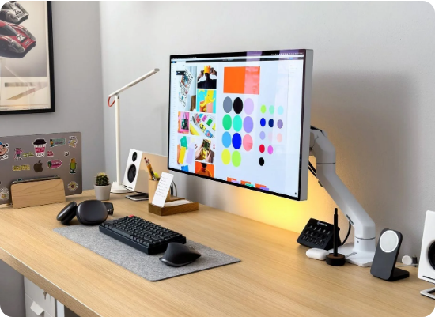
Workspace Customization
•
Changing Wallpaper: Right-click the desktop and select "Personalize". You can choose static pictures, solid background colors, or dynamic slideshows to make your visual workspace visually appealing.
•
Installing a Printer: Navigate to Settings > Bluetooth & devices > Printers & scanners. Click "Add device" allowing Windows to automatically scan for network or USB connected printers.
•
Automatic Driver Setup: Windows Update usually handles the secure installation of required print drivers seamlessly in the background.

Slide 12
Questions?
Thank you for your attention and time today.
IT Training Academy | support@techlearning.edu

Slide 13



Image Sources
https://i.ytimg.com/vi/n9FsiaoJSWo/hq720.jpg?sqp=-oaymwEhCK4FEIIDSFryq4qpAxMIARUAAAAAGAElAADIQj0AgKJD&rs=AOn4CLD_rJKTP9S3l0YlJhCs346IHiRZJA
Source: www.youtube.com
https://biztechmagazine.com/sites/biztechmagazine.com/files/styles/cdw_hero/public/articles/202507/GettyImages-1392155479.jpg?itok=0VbKLdja
Source: biztechmagazine.com
https://www.makerstations.io/wp-content/uploads/2023/11/24-Minimal-Desk-Setup-Ideas.webp
Source: www.makerstations.io

